Slide 1
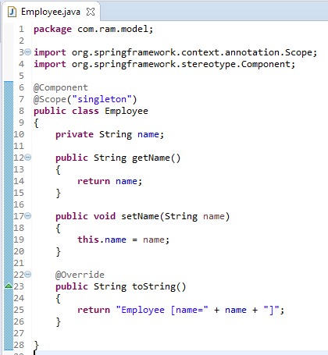
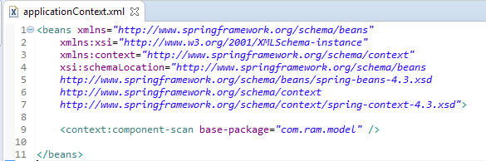
Singleton Scope

Slide 2
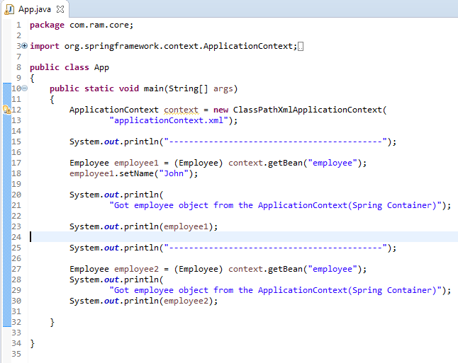
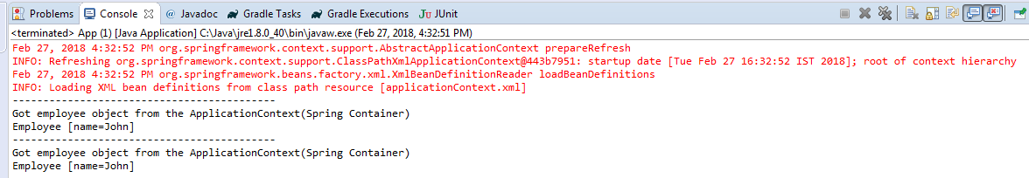
Singleton Scope
Since the bean ‘employee’ is in singleton scope, the second retrieval by ‘employee2’ will display the message set by ‘employee1’ also, even it’s retrieve by a new getBean() method.
In singleton, only a single instance per Spring IoC container, no matter how many time you retrieve it with getBean(), it will always return the same instance.
Spring Container
Scope is singleton, So
Only one Instance
Will be available
employee

